Slide 1
18CSE490T - Big Data Visualization

Slide 2
Introduction
“a picture is worth a thousand words”
That’s because an image can often convey “what’s going on”, more quickly, more efficiently, and often more effectively than words.
Big data visualization techniques exploit this fact: they are all about turning data into pictures by presenting data in pictorial or graphical format

Slide 3
What Is Big Data Visualization?
Big Data visualization involves the presentation of data of almost any type in a graphical format that makes it easy to understand and interpret.
But it goes far beyond typical corporate graphs, histograms and pie charts to more complex representations like heat maps and fever charts, enabling decision makers to explore data sets to identify correlations or unexpected patterns.

Slide 4
What Is Big Data Visualization?
Today’s enterprises collect and store vast amounts of data that would take years for a human to read, let alone understand.
But researchers have determined that the human retina can transmit data to the brain at a rate of about 10 megabits per second.
Big Data visualization relies on powerful computer systems to ingest raw corporate data and process it to generate graphical representations that allow humans to take in and understand vast amounts of data in seconds.

Slide 5
Big Data Visualization – Popular Tools
Zoho Analytics: Focusing on ease of use – a particularly key attribute as data tools grow – Zoho analytics is a self service option. Meaning that users will not need the assistance of IT staff or professional data scientists to glean insight from data.
IBM Cognos Analytics: Driven by their commitment to Big Data, IBM’s analytics package offers a variety of self service options to more easily identify insight.
QlikSense and QlikView: The Qlik solution touts its ability to perform the more complex analysis that finds hidden insights.
Microsoft PowerBI: The Power BI tools enables you to connect with hundreds of data sources, then publish reports on the Web and across mobile devices.

Slide 6
Big Data Visualization – Popular Tools
Oracle Visual Analyzer: A web-based tool, Visual Analyzer allows creation of curated dashboards to help discover correlations and patterns in data.
SAP Lumira: Calling it “self service data visualization for everyone,” Lumira allows you to combine your visualizations into storyboards.
SAS Visual Analytics: The SAS solution promotes its “scalability and governance,” along with dynamic visuals and flexible deployment options.
Tableau Desktop: Tableau’s interactive dashboards allow you to “uncover hidden insights on the fly,” and power users can manage metadata to make the most of disparate data sources.
TIBCO Spotfire: Offers analytics software as a service, and touts itself as a solution that “scales from a small team to the entire organization.”

Slide 7
What is data visualization?
Simply one can think of the two words,
data meaning -- information/numbers and
visualization meaning picturing, or picturing the information

Slide 8
WHY DATA
VISUALIZATION
The greatest value of
a picture is when
it forces us to notice
what we never
expected to see.
—John Tukey
The human brain can
process an entire image for
as little as 13 milliseconds
About 80% of the information
we take in, is by eye
The human brain processes
visuals 60,000 times faster
than words

Slide 9
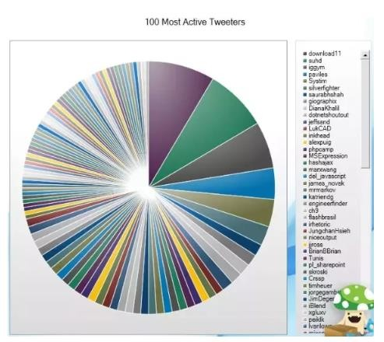
WHAT IS WRONG IN THIS CHART?

Slide 10
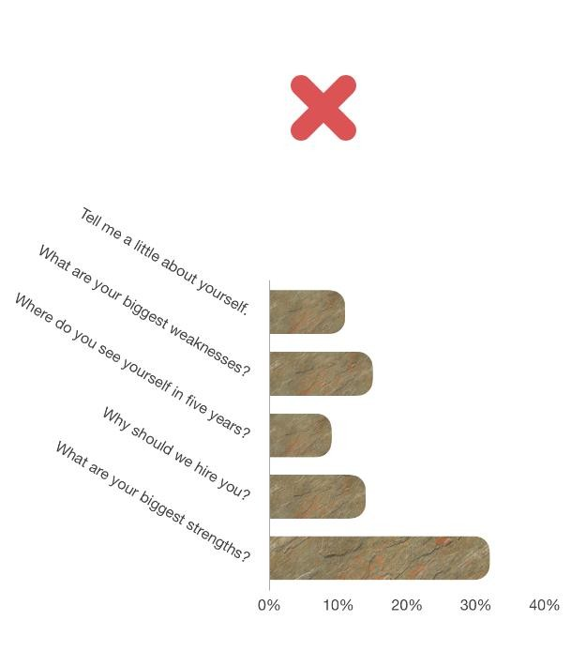
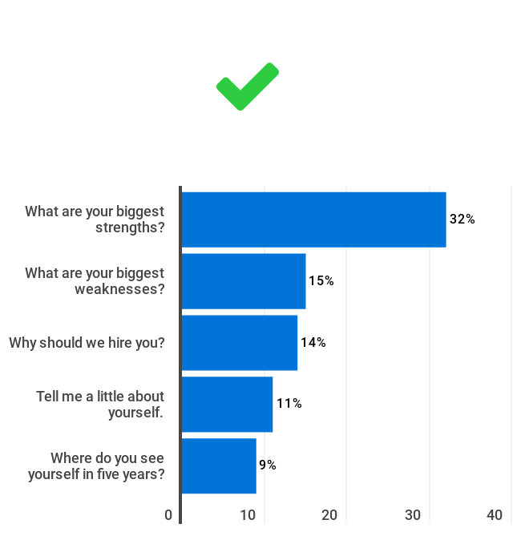
WHAT IS WRONG IN THIS CHART?

Slide 11
Motives for using data visualization includes:
To explain the data or put the data in context (that is, highlight demographical statistics)
To solve a specific problem, (for example, identifying problem areas within a particular business model)
To explore the data to reach a better understanding or add clarity (that is, what periods of time does this data span?)
To highlight or illustrate otherwise invisible data (such as isolating outliers residing in the data)
To predict, for example, potential sales volumes (perhaps based upon seasonality sales statistics)

Slide 12
As per Data Visualization: The future of data visualization, Towler, 2015:
“Data visualization is entering a new era. Emerging sources of intelligence, theoretical developments, and advances in multidimensional imaging are reshaping the potential value that analytics and insights can provide, with visualization playing a key role.”

Slide 13
How to choose the correct or most effective visualization method ?
The size and volume of the data to be visualized.
The data's cardinality and context.
What is it you are trying to communicate? What is the point that you want to communicate?
Who is your audience? Who will consume this information?
What kind or type of visual might best convey your message to your audience?

Slide 14
Most common visualization methods/types include:
Table
Histogram
Scatter plot
Line, bar, pie, area, flow, and bubble charts
Data series or a combination of charts
Time line
Venn diagrams, data flow diagrams, and entity relationship (ER) diagrams

Slide 15
Other options
Word/Text/Tag clouds
Network diagrams
Parallel coordinates
Tree mapping
Cone trees
Semantic networks
Data visualization types/methods speak to a particular scenario or target audience better than others
Learning to make the appropriate choice comes from experience as well as (sometimes) a bit of trial and error.

Slide 16
Challenges of big data visualization
Big data
A large assemblage of data and datasets that are so large or complex that traditional data processing applications are inadequate and data about every aspect of our lives has all been used to define or refer to big data.
In 2001, then Gartner analyst Doug Laney introduced the 3Vs concept
Volume (or the measurable amount of data)
Variety (meaning the number of types of data), and
Velocity (referring to the speed of processing or dealing with that data).

Slide 17
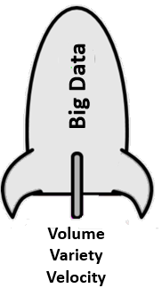
Pushing big data higher

Slide 18
Volume
Volume involves determining or calculating how much of something there is,
or in the case of big data, how much of something there will be
With every click of a mouse, big data grows to be petabytes (1,024 terabytes) or even
Exabyte's (1,024 petabytes) consisting of billions to trillions of records generated from millions of people and machines.

Slide 19
Velocity
Velocity is the rate or pace at which something is occurring.
The measured velocity experience can and usually does change over time.
Velocities directly affect outcomes.

Slide 20
Variety
relational databases are considered to be highly structured, although they may contain text in VARCHAR2, CLOB, or BLOB fields.
Data today comes from many kinds of data sources, and the level in which that data is structured varies greatly from data source to data source
Formats that go beyond pure text, photo, audio, video, web, GPS data, sensor data, relational databases, documents, SMS, pdf, flash, and so on

Slide 21
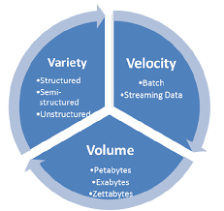
3Vs

Slide 22
Categorization
The process of categorization helps us to gain an understanding of the data source.
Industry commonly categorizes big data this way–into the two groups (structured and unstructured)
but the categorizing doesn't stop there.

Slide 23
Structured Data vs Unstructured Data
Structured data includes subcategories such as
created,
provoked,
transactional,
compiled, and
experimental,
while unstructured data includes subcategories such as
captured
submitted

Slide 24
1. Created data
This is the data being created for a purpose;
such as focus group surveys or asking website users to establish an account on the site (rather than allowing anonymous access).

Slide 25
2. Provoked data
This is described as data received after some form of provoking,
perhaps such as providing someone with the opportunity to express the individual's personal view on a topic,
such as customers filling out product review forms.

Slide 26
3. Transactional data
This is data that is described as database transactions,
for example, the record of a sales transaction.

Slide 27
4. Compiled data
This is data described as information collected (or compiled) on a particular topic such as credit scores.

Slide 28
5. Experimental data
when someone experiments with data and/or sources of data to explore potential new insights.
For example, combining or relating sales transactions to marketing and
promotional information to determine a (potential) correlation.

Slide 29
1. Captured data
This is the data created passively due to a person's behavior
like when you enter a search term on Google - perhaps the creepiest data of all!

Slide 30
2. User-generated data
This is the data generated every second by individuals, such as from Twitter, Facebook, YouTube, and so on
compared to captured data, this is data you willingly create or put out there.

Slide 31
Final words on Data
To sum up, big data comes with no common or expected format
and the time required to impose a structure on the data has proven to be no longer worth it

Slide 32
Additional challenging areas that big data brings to the table
the ability to effectively deal with
data quality,
outliers, and
to display results in a meaningful way, to name a few.

Slide 33
Data quality
The value of almost anything and everything is directly proportional to its level of quality and higher quality is equal to higher value.
The general areas of data quality include:
Accuracy
Completeness
Update status
Relevance
Consistency (across sources)
Reliability
Appropriateness
Accessibility

Slide 34
Data quality
The quality of data can be affected by the way it is entered, stored, and managed and the process of addressing data quality
requires a routine and regular review and evaluation of the data, and
performing on going processes termed profiling and scrubbing
“Data profiling is the process of examining the data available in an existing data source (e.g. a database or a file) and collecting statistics and information about that data”
“Data scrubbing is the process of detecting and correcting (or removing) corrupt or inaccurate records from a record set, table, or database.”

Slide 35
Dealing with outliers
As per Sham Mustafa, founder and CEO of data scientist marketplace Correlation One:
“Anyone who is trying to interpret data needs to care about outliers”.
It doesn't matter if the data is financial, sociological, medical, or even qualitative.
Any analysis of that data or information must consider the presence and effect of outliers.
Outliers (data that is “distant” from the rest of the data) indicating variabilities or errors – need to be identified and dealt with.

Slide 36
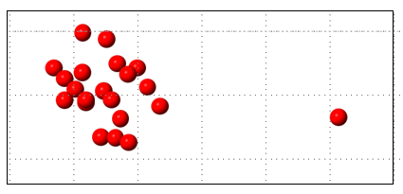
Dealing with outliers
The following is a simple figure introducing the concept of an outlier, that is, one lonesome red dot separated from the group:
Once identified, regularly accepted methods for dealing with these outliers may be (simply?) moving them to another file or replacing the outliers with other more reasonable or appropriate values.

Slide 37
Meaningful displays
Rather than words or text, a diagram clearly demonstrates the power of a visualization when conveying information
A picture is worth a thousand words and Seeing is believing are just two adages that elucidate the powers of data visualization.
As per Millman/Miller Data Visualization: Getting Value from Information 2014:
“The whole point of data visualization is to provide a visual experience.”
Data visualization is a key technique permitting individuals to perform analysis, identify key trends or events, and make more confident decisions much more quickly.

Slide 38
Adding a fourth V
The idea of establishing and improving the quality levels of big data might also be classified as the fourth V: veracity-conformity to facts; accuracy.
Can I trust this data?.
The uncertainty that comes with big data may cause the perhaps valuable data to be excluded or over looked.
A method for dealing with big data veracity is by assigning a veracity grade or veracity score for specific datasets to evade making decisions based on analysis of uncertain and imprecise big data.

Slide 39
Visualization philosophies
A meaningful display requires you to pay attention to various proven practice philosophies;
these concepts include (but are not limited to):
The proper arrangement of related information
Appropriately using color(s)
Correctly defining decimal placements
Limiting the use of 3D effects or ornate gauge designs

Slide 40
More on variety
Without context, data is meaningless and the same applies to visual displays (or visualizations) of that data.
different insights depending on user demographics (that is, age group, sex, or income bracket),
platform (that is, Facebook or Twitter), or audience (those who intend to consume the visualizations).
Acquiring a proper understanding (establishing a context) of the data takes significant domain expertise as well as the ability to properly analyze the data

Slide 41
Velocity
Even if you are able to assign the appropriate context to your data, the usability or value of the data will be (at least) reduced if the data is not timely.
For example,
when a state government agency is preparing a budget request for the governor, the most up-to-date consensus figures are vital;
without accuracy, here, the funds may fall short of the actual needs.

Slide 42
Volume
Too much information displayed in one place can cause sensory overload
Example - the available viewing space on a web page or monitor
the more data you need to process to create or refresh your visualization,
the longer wait time there will most likely be
will increase audience frustration levels and usability and value of the visualization

Slide 43
All is not lost
Thankfully, there are various approaches (or strategies) that have come to exist
addressing the hindrances we've mentioned (variety, velocity, volume, and veracity).
Some of the examples include:
You can change the type of the visualization, for example, switching from a column graph to a line chart can allow you to handle more data points within the visualization

Slide 44
Examples
You can use higher-level clustering. In other words, you can create larger, broader stroke groupings of the data to be represented in the visualization
You can remove outliers from the visualization. Outliers typically represent less than 5 percent of a data source,
but when you're working with massive amounts of data, viewing that 5 percent of the data is challenging. Outliers can be removed
You can consider capping, which means setting a threshold for the data you will allow into your visualization.
This cuts down on the range or data making for a smaller, more focused image.
These strategies (and others) help, but aren't really sufficient when it comes to working with big data.

Slide 45
Approaches to big data visualization
Access, speed, and storage
Hadoop
Context
Quality

Slide 46
Access, speed, and storage
Dealing with expanding data sizes may lead to perpetually expanding a machines resources, to cover the expanding size of the data.
When dealing with data too large to handle with a single machine's memory (that is, big data) a common approach is to sample the data,
try to construct a smaller dataset from the full dataset
Using Hadoop, you have the ability to run many exploratory data analysis tasks on full datasets, without sampling, with the results efficiently returned to your machine or laptop.

Slide 47
Hadoop
The Hadoop online product documentation points out:
”Data which was previously too expensive to store, can now be stored and made available for analysis to improve business insights at 1/10 to 1/50 the cost on a per terabyte basis.”

Slide 48
Context
The appropriate use of context in analytics makes all the difference toward achieving optimal results
Adding context to data requires manipulation of that data to review and perhaps reformat, adding calculations, aggregations, or additional columns or re-ordering, and so on.

Slide 49
Quality
Good data means less time spent hunting around for the right phone number or email or mailing address.
How many times have you seen customer records with badly formatted phone numbers or erroneous email addresses?
The importance here is also on the recognition that systems set up to accept US mailing addresses or phone numbers must also work beyond the borders of North America. Zip codes outside the US are not always numeric and telephone area codes are not always composed of three digits. Having a system that does not truncate field values to fit a US-model is therefore imperative.

Slide 50
Typically, the first step in determining the quality of your data is performing a process referred to as profiling the data
Typical profiling tasks include the following:
Identifying fields/columns within the data
Listing field/column attributes and statistics such as column lengths and value
distribution percentages
Reviewing field/column value distributions
Null ratios
Notes:
Prepared by P.Rajasekar
Asst. Professor, SRMIST

Slide 51
Reporting of value statistics such as minimum, maximum, average, and standard deviation for numeric columns, and minimum and maximum for date and time columns
Identifying all the distinct values in the data
Identifying patterns and pattern distributions within the data
The goal of these tasks (and others) is to establish your data's profile
by determining its characteristics, relationships, and patterns within the data and,
hopefully, produce a clearer view of the content and quality of your data, that is, the data profile.

Slide 52
Data scrubbing- made up of the following efforts:
Defining and determining errors within the data–what do you consider an error?
Searching and identifying error instances–once an error is defined, where do they exist in your data?
Correction of the errors–remove them or update them to acceptable values.
Error instance and document error types–or labeling (how was the error determined and what was done to resolve it).
Updating the entry mechanism to avoid future errors – create a process to make sure future occurrences of this type are dealt with.

Slide 53
Displaying results - enable your audience to:
See the results of your analysis efforts more clearly
Simplify the complexities within the data you are using
Understand and grasp a point that you are using the data to make

Slide 54
Not a new concept
has been around for literally centuries, from the manual
creation of maps and graphs in the 17th century to the invention of the pie chart in the early 1800s.
Today, computers can be used to process large amounts of data lightning fast to make visualizations tremendously more valuable.
Going forward, we can expect the data visualization process to continue to evolve,
perhaps as more of a mixture of art and science rather than a numbers crunching technology.

Slide 55
Instant gratifications
generating and publishing charts and graphs for an audience to review and set up an expectation for interactive visualizations.
giving the user the self-service ability to drill down into the generated pictures, charts, and graphs (to access more or specific details),
interactively in real time (or near real time) to change what data is displayed and how it's processed and/or presented (maybe select a bar graph rather than a pie chart).
This allows visualizations to be much more effective and personalized.

Slide 56
Data-driven documents
Data Driven Documents is referred within the open community as D3.
D3 is an open source library written in JavaScript.
The objective is to allow for easily manipulating documents based upon data using standard web browsing technologies (such as HTML or CSS)
Its value-add is to provide you with full capabilities without having to build your own or strapping yourself to some proprietary framework.
These library components give you excellent tools for big data visualization and a data driven approach to DOM manipulation

Slide 57
Dashboards
Big data is collecting and accumulating daily, in fact; minute-by-minute and there is a realization that organizations rely on this information for a variety of reasons.
Various types of reporting formats are utilized on this data, including data dashboards.
“A dashboard is a visual display of the most important information needed to achieve one or more objectives; consolidated and arranged on a single screen so the information can be monitored at a glance.”
-According to A. Chiang

Slide 58
Dashboards ..2
any dashboard has the capacity for supplying timely, important information for its audience to use in decision making, if it is well designed and constructed.
Making decisions based upon a dashboard with incorrectly presented, stale, or even incorrect data can lead to disaster.
Tableau is categorized as business intelligence software designed to help people see and understand data;
more than just a code library, Tableau is considered to be a suite or a family of interactive data visualization products.

Slide 59
Tableau
Tableau also works with a variety of formats of both structured and unstructured data
can handle the volumes of big data, literally, petabytes or terabytes,
millions or billions of rows, turning that big data into valuable visualizations for targeted audiences.

Slide 60
Tableau ..2
Some of the more exciting abilities Tableau offers include:
Real-time drag-and-drop cluster analysis
Cross data source joining
Powerful data connectors
Mobile enabled
Real-time territory or region data exploration

Slide 61
Outliers
an outlier is an observation point that is distant or vastly different from the other observed data points within the data.
Although outliers typically represent (only) about 1 to 5 percent of your data,
when you’re working with big data, investigating, or even just viewing, 1 to 5 percent of that data is rather difficult.

Slide 62
Investigation and adjudication
Outliers can be determined to be noninfluential or very influential to the point you are trying to make with your data visualization.
determination is critically important to your analysis, but
it is problematic when dealing with the larger volumes, many varieties, and velocities of big data.
an automated process can be created that can facilitate at least the identification of outliers, possibly even through the use of visualization.
Python's standard library is very extensive, offering a wide range of built-in modules that provide access to system functionalities,
as well as standardized solutions to solve many problems that occur in everyday programming
making this an obvious choice to explore for dealing with big data outliers and related processing.

Slide 63
Operational intelligence
(OI) is a type of analytics that attempts to deliver visibility and
insight from (usually machine generated) operational or event data, running queries against streaming data feeds in real time, producing analytic results as operational instructions,
which can be immediately acted upon by an organization, through manual or automated actions (a clear example of turning datasets into value!)
We use log files to explore more operational intelligence

Slide 64
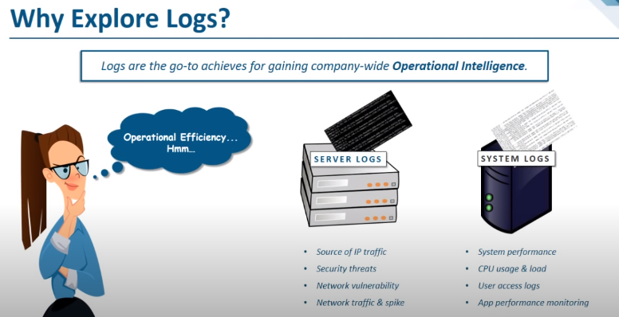
Need to explore Logs

Slide 65
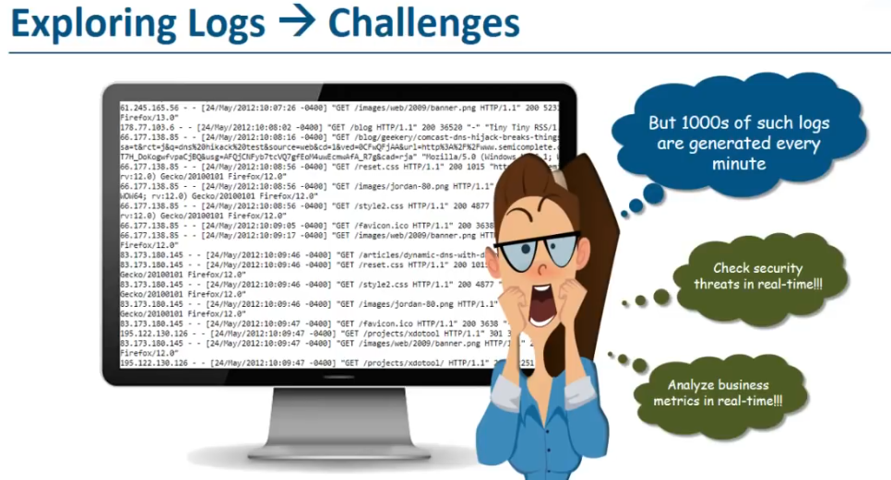

Slide 66
for example, machine-generated operational data is typically full of unique identifiers and result or status codes.
These codes or identifiers may be efficient for processing and storage, but are not always easily interpreted by human beings.
To make this data more readable we can associate additional information that is more user friendly with the data results
possibly in the form of a status or event description or perhaps a product name or machine name.

Slide 67
Splunk
Splunk software is a great tool to help unlock hidden value in machine generated, operational data (as well as other types of data).
With Splunk, you can collect, index, search, analyze, and visualize all your data in one place,
providing an integrated method to organize and extract real-time insights from massive amounts of (big data) machine data from virtually anywhere.
It has own Search Processing Language (SPL).
Splunk SPL is an extremely powerful tool for searching enormous amounts of big data and
performing statistical operations on what is relevant within a specific context.

Slide 68
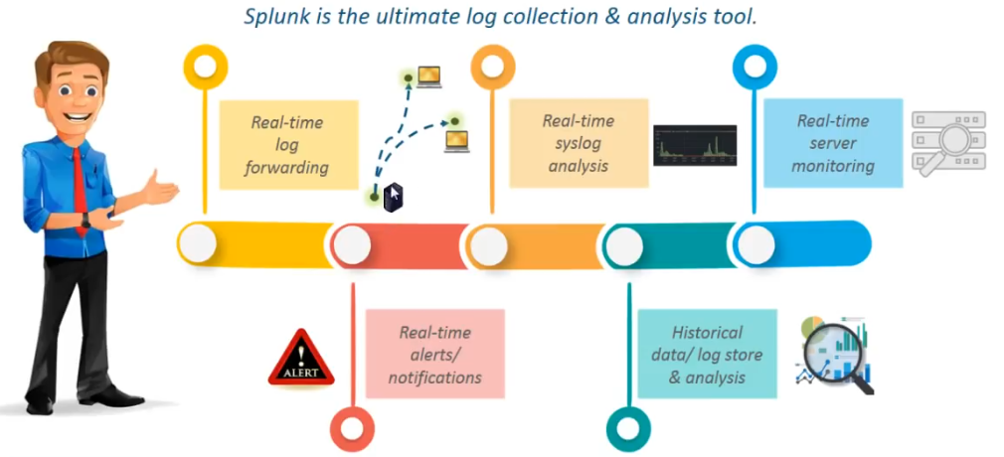

Slide 69
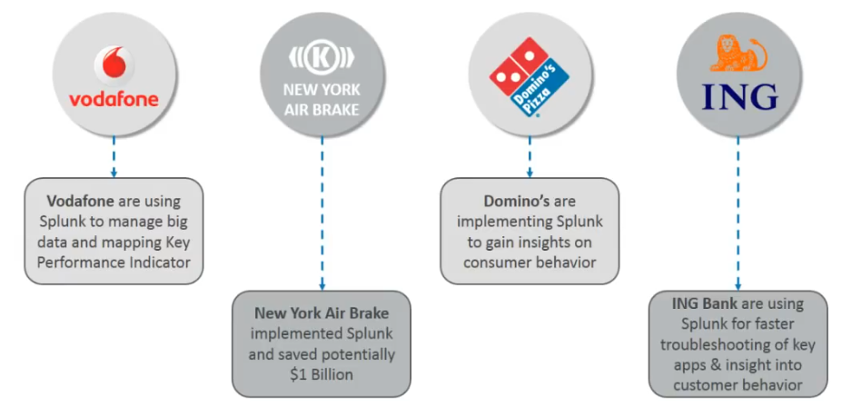

Slide 70
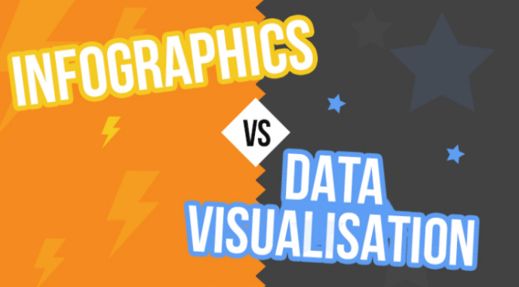

Slide 71
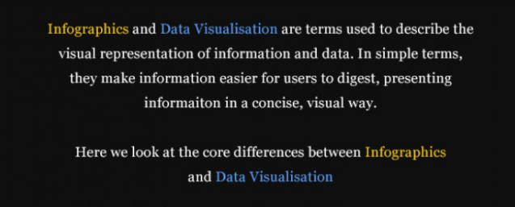

Slide 72
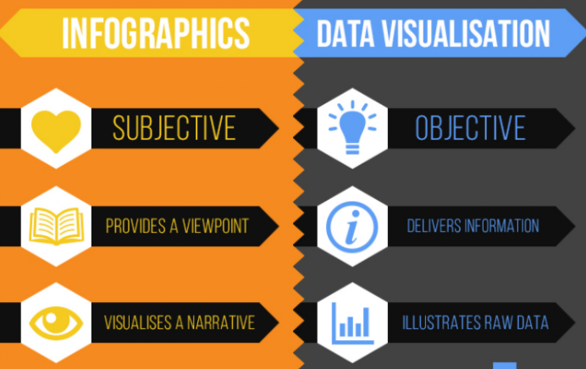

Slide 73
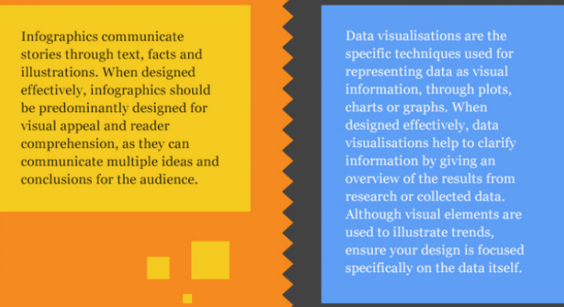

Slide 74
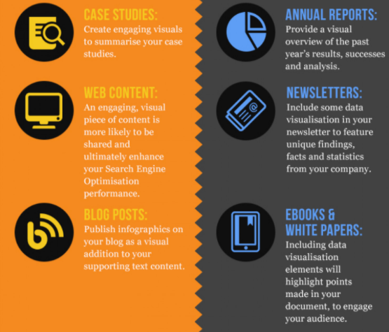

Slide 75
Some people use infographic to refer to representations of information perceived as casual, funny or frivolous
Data Visualization to refer to designs perceived to be more serious, rigorous, or academic
data visualization or information visualization
(casually, data viz and info viz)

Slide 76
Infographics is useful for referring to any visual representation of data that is:
manually drawn (and therefore a custom treatment of the information);
specific to the data at hand (and therefore nontrivial to recreate with different data);
aesthetically rich (strong visual content meant to draw the eye and hold interest);
relatively data-poor (because each piece of information must be manually encoded).

Slide 77
Data visualization is useful for referring to any visual representation of data that is:
algorithmically drawn (may have custom touches but is largely rendered with the help of computerized methods);
easy to regenerate with different data (the same form may be repurposed to represent different datasets with similar dimensions or characteristics);
often aesthetically barren (data is not decorated); and
relatively data-rich (large volumes of data are welcome and viable, in contrast to infographics).
Advantage - relatively simple to update or regenerate the visualization with more or new data.

Slide 78
Two categories of data visualization: Exploration and Explanation.
Exploratory data visualizations are appropriate when you have a whole bunch of data and you’re not sure what’s in it.
When you need to get a sense of what’s inside your data set, translating it into a visual medium can help you quickly identify its features, including interesting curves, lines, trends, or anomalous outliers.
high level of granularity
Part of analysis phase -> to find the story the data has to tell you

Slide 79
explanatory data visualization is appropriate when you already know what the data has to say, and you are trying to tell that story to somebody else
Whoever your audience is, the story you are trying to tell (or the answer you are trying to share) is known to you at the outset
process of selecting focused data that will support the story you are trying to tell.
part of the presentation phase -> a speech, a newspaper article, or a report

Slide 80
Informative versus Persuasive versus Visual Art
Three main categories of explanatory visualizations based on
the relationships between the three necessary players:
the designer,
the reader, and
the data.
If you don’t know the message you intend to convey, then you’re still in an exploration phase

Slide 81
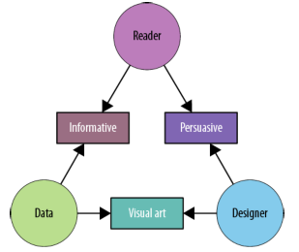
An effective explanatory data visualization as being supported by
a three-legged stool consisting of the designer, the reader, and the data.
Each of these “legs” exerts a force, or contributes a separate perspective, that must be taken into consideration for a visualization to be stable and successful
The nature of the visualization depends on which relationship (between two of the three
components) is dominant.

Slide 82
Informative visualization
This primarily serves the relationship between the reader and the data.
It aims for a neutral presentation of the facts in such a way that will educate the reader (though not necessarily persuade him)
Informative visualizations are often associated with broad data sets, and seek to distill the content into a manageably consumable form.
the average person encounters on a day-to-day basis

Slide 83
Persuasive visualization
This primarily serves the relationship between the designer and the reader.
It is useful when the designer wishes to change the reader’s mind about something.
It represents a very specific point of view, and advocates a change of opinion or action on the part of the reader.
specifically chosen for the purpose of supporting the designer’s point of view
is also presented carefully so as to convince the reader

Slide 84
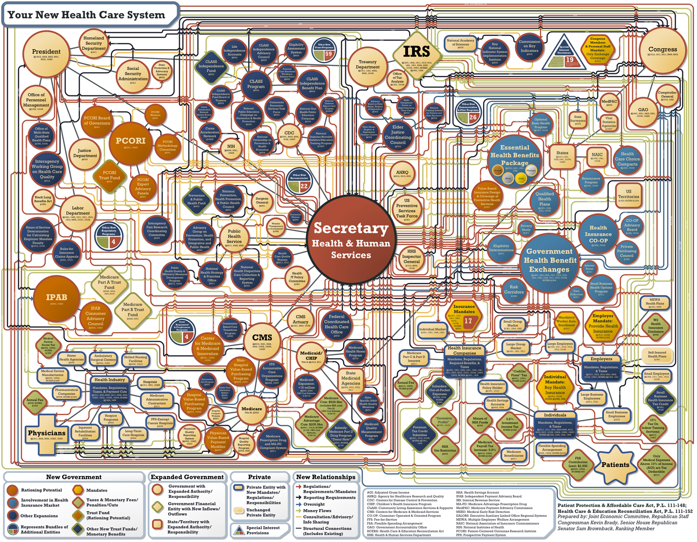
The chart itself doesn’t leave the reader with any actual information other than, “Wow, this system is complicated.”

Slide 85
Visual Art
primarily serves the relationship between the designer and the data.
unidirectional encoding of information, meaning that the reader may not be able to decode the visual presentation to understand the underlying information.
Whereas both informative and persuasive visualizations are meant to be easily decodable—bidirectional in their encoding
visual art merely translates the data into a visual form.
The designer may intend only to condense it, translate it into a new medium, or make it beautiful;

Slide 86
Ingredients of Successful Visualizations
This applies mainly to explanatory visualization.
While exploratory visualization is more about you finding out what’s in your data,
explanatory visualization is about you as a designer telling the story of the data to your reader.
Designer
Reader
Data

Slide 87
Designer
As a designer, you have a goal
You may not be aware of it, but you are creating a visualization for some reason
Being aware of your motivations, goals, and priorities will help you design a successful visualization,
rather than merely create an arbitrary visual representation of your data

Slide 88
Reader
The second source of influence is the reader.
As the intended recipient of your ideas, the reader holds a very special place in the trinity and can be your biggest ally or your
biggest hurdle in clear communication—sometimes both.
Your success is measured by your reader’s success.
Another benefit to putting yourself in the reader’s shoes is that it will force you to simplify your explanations a bit.
purpose of the visualization is to take a story that is already known to you and tell it to somebody else

Slide 89
Another thing to consider is learned social context
What do colors mean?
Which direction it the reader used to reading in?
Which icons is he/she familiar with?

Slide 90
Context of Use
The key questions to ask here are ones like:
What information does my reader need to be successful?
How much detail does he/she need?
How long does he/she have to make it effective?
Once you understand the context in which the reader is operating, you can discern which information he/she needs

Slide 91
Data
The third source of influence in designing a visualization is your data
The best visualizations will reveal what is interesting about specific data set
Different data may require different approaches, encodings, or techniques to reveal its interesting aspects.

Slide 92
The type of basic questions you will want to ask about your data include:
Is it a time-series? A hierarchy?
How many dimensions does it have? Which are the most important ones?
What sort of relationships do they have (e.g., one-to-one or many-to-many)?
How many variables are they?
Are the values categorical? Discrete or continuous? Linear or non-linear? How are they bounded?
How many categories are there?
understanding about the shape of your data will inform your design decisions.

Slide 93
Choose Appropriate Visual Encodings
Natural Ordering
Distinct Values
Redundant Encoding
Default Vs Innovative formats

Slide 94
Natural Ordering
Whether a visual property has a natural ordering is determined by whether the mechanics of our visual system and the “software” in our brains automatically—unintentionally—assign an order, or ranking, to different values of that property.
Position, length, Line thickness or weight has a natural ordering;
Texture, line style (solid, dotted, dashed) doesn’t.
Quantitative differences (27, 33, 41), or
Ordinal differences (small, medium, large, enormous).

Slide 95
Color is not ordered
We have strong social conventions about color
there is an ordering by wavelength in the physical world
but color does not have a non-negotiable natural ordering built into the brain.
You can’t depend on everyone to agree that yellow follows purple in the way that you can depend on them to agree that four follows three.

Slide 96
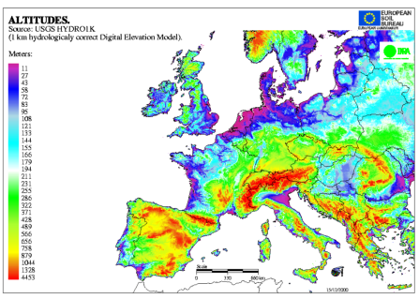

Slide 97
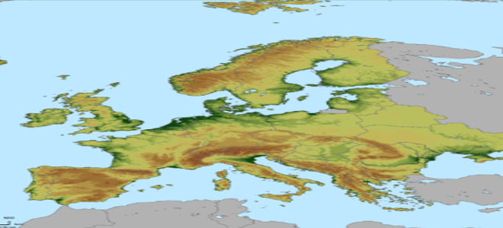
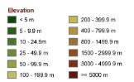

Slide 98
Distinct Values
how many distinct values it has that your reader will be able to perceive, differentiate, and possibly remember.
We can more easily differentiate a large number of shapes, a huge number of positions, and an infinite number of numbers.
When choosing a visual property, select one that has a number of useful differentiable values and an ordering similar to that of your data

Slide 99
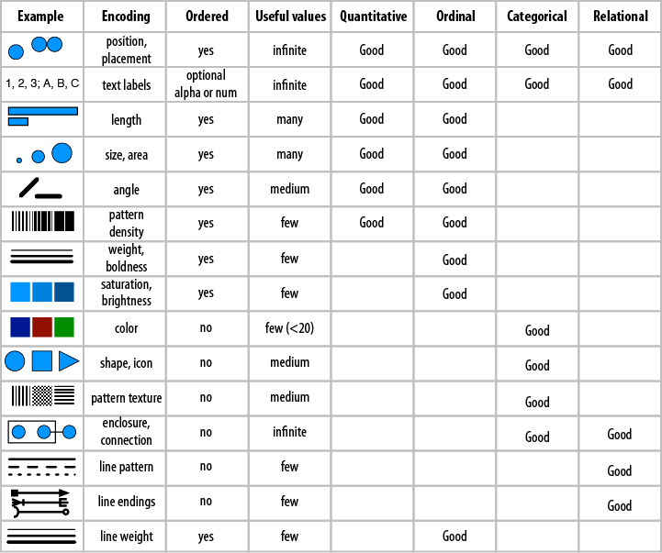

Slide 100
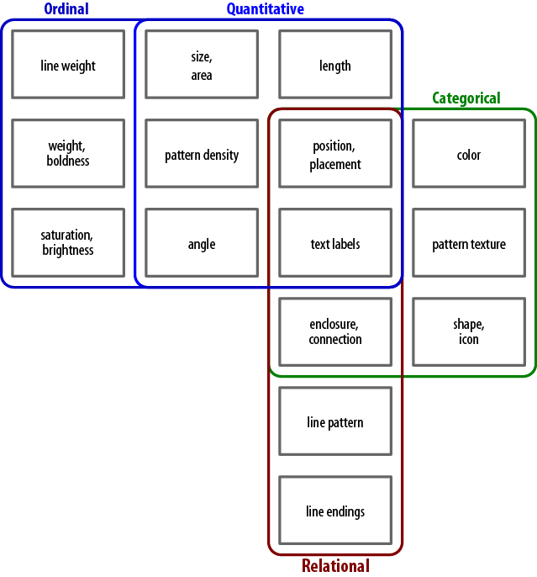

Slide 101
Redundant Encoding
If you have the luxury of leftover, unused visual properties after you’ve encoded the main dimensions of your data,
consider using them to redundantly encode some existing, already-encoded data dimensions.
The advantage of redundant encoding is that using more channels to get the same information into your brain can make acquisition of that information faster, easier, and more accurate
Notes:
Prepared by P.Rajasekar
Asst. Professor, SRMIST

Slide 102
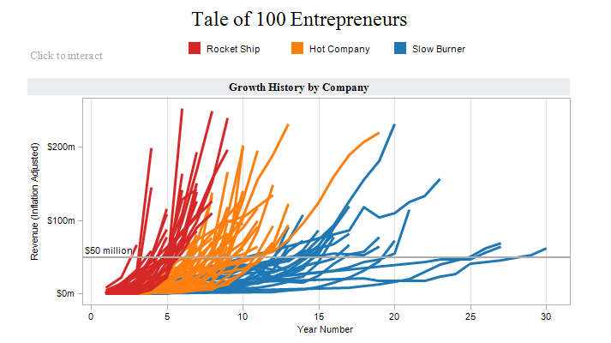
adding color more strongly defined the groupings that weren’t strongly defined before,
but those groups are a subset of the information already provided by position.
For that reason, in this case color adds slightly more informational value beyond mere redundancy.

Slide 103
Defaults versus Innovative Formats
Designing new encoding formats can cost you a lot of time and effort, and may make your reader expend a lot of time and effort to learn.
Knowing the expected defaults for your industry, data type, or reader can save you a lot of work when it comes to both figuring out how to best encode your data, and how to explain it to your readers
Try to find new ways to say things
What is the expense to you and your reader of creating and understanding a new encoding format, versus the value delivered by that format?

Slide 104
Defaults versus Innovative Formats ..2
If you’ve got a truly superior solution (as evaluated by your reader, and not just your ego), then by all means, use it
But if your job can be done (or done well enough) with a default format, save everyone the effort and use a standard solution.

Slide 105
Readers’ Context
Remember your audience will likely be composed of more than one reader
They may be as different from each other as they are from you,
will likely have very different backgrounds and
Different levels of interest in your work
Titles, tags, and labels
Colors
Color blindness
Directional orientation

Slide 106
Titles, tags, and labels
Consider your reader’s vocabulary and familiarity with relevant jargon.
Is the reader from within your industry or outside of it? What about other readers outside of the core audience group?
Is it worth using an industry term for the sake of precision, or would a lay term work just as well?
Will the reader be able to decipher any unknown terms from context, or will a vocabulary gap obscure the meaning of all or part of the information presented?

Slide 107
Colors
There is quite a bit of science about how our brains perceive and process color that is somewhat universal
Depending on the culture in question, some colors may be lucky, some unlucky;
Some may carry positive or negative meanings;
Some may be associated with life events like weddings, funerals, or newborn children.

Slide 108
Color blindness
Color blindness is properly referred to as color vision deficiency or dyschromatopsia
About 7% of American men experience some kind of color perception disorder (women are much more rarely affected: about 0.4 percent in America)
Red-green deficiency is the most common by far, but yellow-blue deficiency also occurs
Lots of people have trouble distinguishing between close colors like blue and purple.

Slide 109
Directional orientation
Is the reader from a culture that reads left-to-right, right-to-left, or top-to-bottom?
Arabic, Hebrew, Persian, and Urdu - right-to-left
A person’s habitual reading patterns will determine their default eye movements over a page
European cartographers, who designed maps over hundreds of years with their own continent as the center of the world.
It will also affect what the reader perceives as “earlier” and “later” in a timeline, where the edge that is read from will be “earlier” and time will be assumed to progress in the same direction as your reader typically reads text.

Slide 110
Compatibility with Reality
Make life easier for your reader
To make decoding easy is to make your encodings of things and relationships as well aligned with the reality of those things and relationships as possible;
This alignment is called compatibility

Slide 111
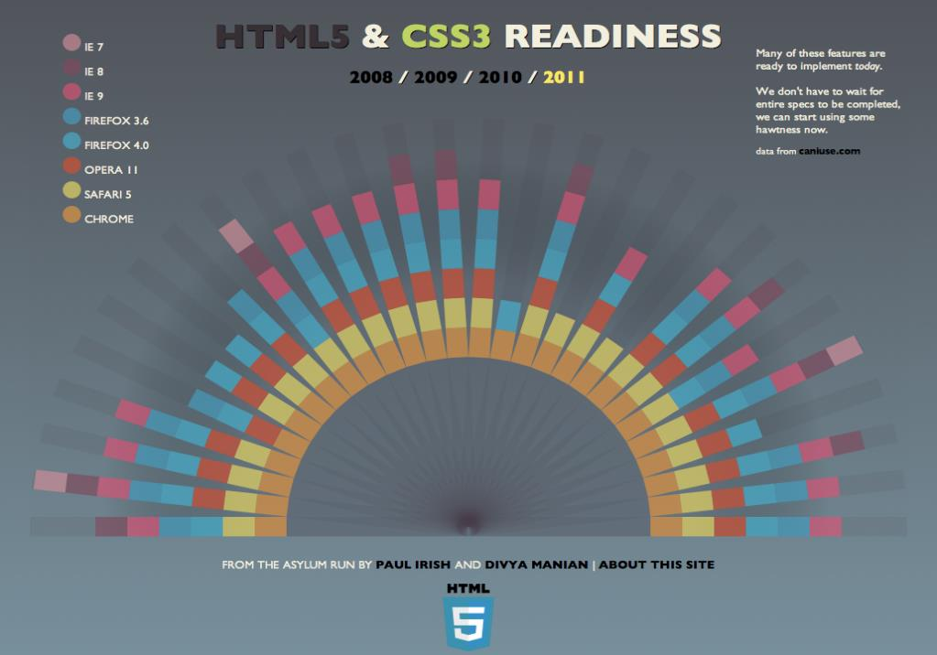
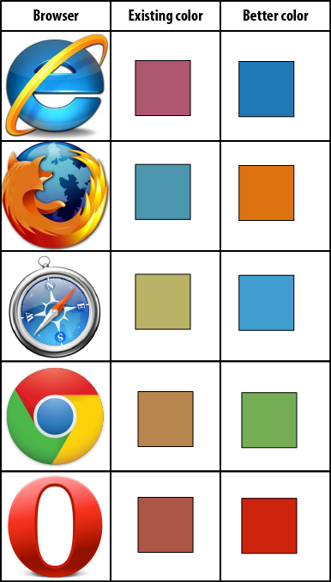
https://html5readiness.com/

Slide 112
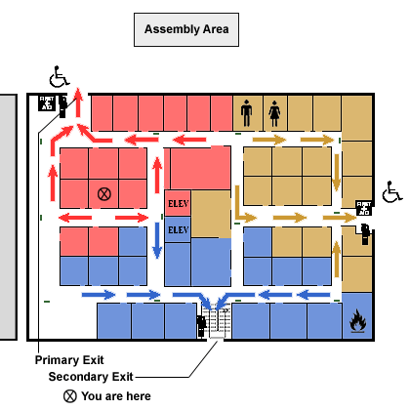
Direction and reality
Imagine your Google map
showing in wrong orientation

Slide 113
Patterns and Consistency
The human brain is amazingly good at identifying patterns in the world
We easily recognize similarity in shapes, position, sound, color, rhythm, language, behavior, and physical routine, just to name a few variables
This ability to recognize patterns is extremely powerful, as it enables us to identify stimuli that we’ve encountered before, and predict behavior based on what happened the last time we encountered a similar stimulus pattern.

Slide 114
Selecting Structure
The structure of a visualization should reveal something about the underlying data.
Take, for example, one of the most classic data visualizations: the Periodic Table of the Elements
It takes a complex dataset and makes it simple, organized, and transparent
The elements are laid out in order by atomic number, and by wrapping the rows at strategic points, the table reveals that elements in various categories occur at regular intervals, or periods

Slide 115
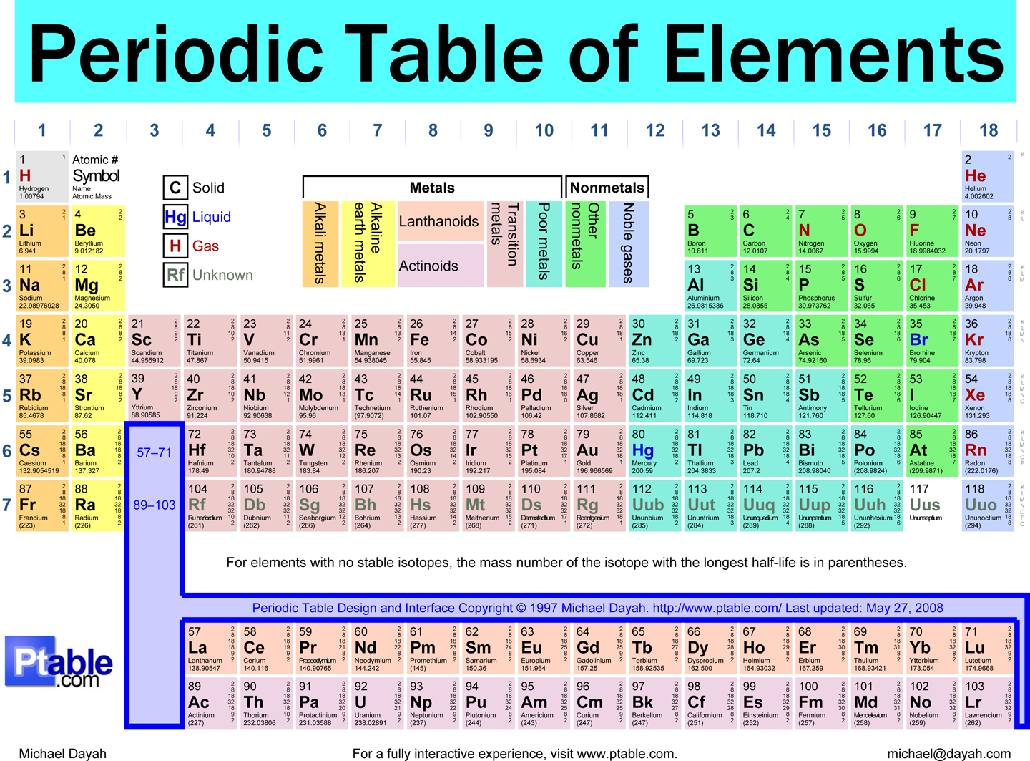

Slide 116
Selecting Structure
Comparisons Need to Compare
Some Structures Are Just Inherently Bad
Some Good Structures Are Often Abused
Keep It Simple (or You Might Look) Stupid

Slide 117
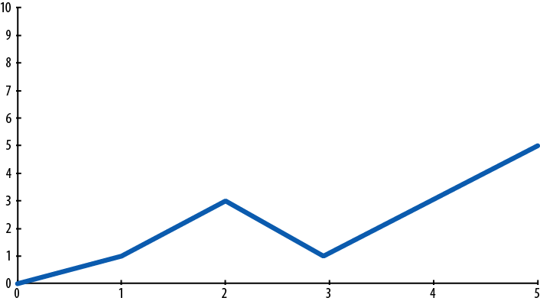
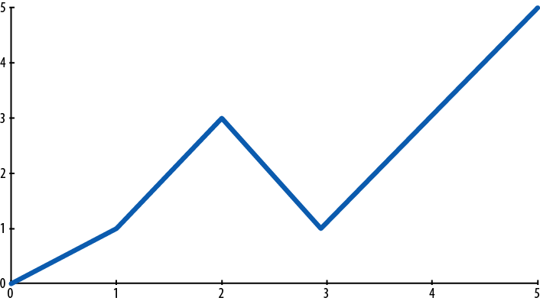
Comparisons Need to Compare
If you intend to allow comparison of values, set the representations up in equivalent ways, and then put them close together. You wouldn’t ask people to look at two versions

Slide 118
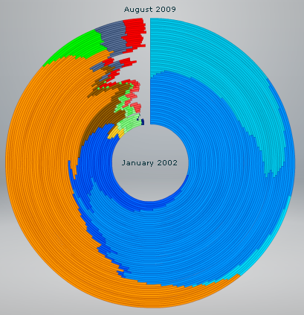
Some Structures Are Just Inherently Bad
Each of the concentric rings are essentially pie charts showing the percentage of visitors using each browser for a particular time slice, starting with January 2002 in the center and working out to August 2009

Slide 119
Some Good Structures Are Often Abused
If your data is tied to population but your display is based on regional size, the proportionally larger surface areas of some regions may inflate the appearance of trends in those regions.
Consider using a table or bar graph instead.

Slide 120
Keep It Simple (or You Might Look) Stupid
Sometimes a designer will make the visualization more complicated than it need to be,
Every dot, line and word should serve a communicative purpose
If it is extraneous or outside the scope of the visualization’s goals, it must go
Edit ruthlessly
Don’t decorate your data.

Slide 121
All about placements, attributes, etc.,
So far we learned how to define our goals, identify some supporting data, and consider appropriate visual encodings,
it’s time to think about the particulars of how to apply those encodings.
decisions about what placement will signify and where particular visual entities will go on the page,
what attributes (such as color, size, and texture) you will assign them, and how you will label and describe them.
We’ll start with a discussion of spatial position—axes and placement
this property defines the scope and visual landscape that your visualization will occupy.

Slide 122
Position: Layout and Axes
Axes (and the resulting layout), placement, and position of entities are perhaps the most underutilized visual encodings.
While axes are frequently defined, they are often not used to their fullest potential, or not assigned at all
When this happens, opportunities to communicate information are lost or wasted, efficiency suffers, understanding becomes more difficult, and your reader cries.

Slide 123
Position Is Your Most Powerful Encoding
Physical position is the easiest to perceive and most powerful visual property,
Position can encode as many discrete values as you have room to display and
can indicate ordered, temporal, categorical, quantitative, or quantitative values, as well as causal, correlative, sequential, qualitative, or quantitative relationships.

Slide 124
Consider the periodic table once again.
It’s clear that the periods and groups, encoded in the rows and columns, are the defining characteristic of the table.
Well-defined axes and the corresponding placement of each element are responsible for making the periodic table the valuable tool that it is.
The axes allow readers to find (and predict the existence of) elements of interest,
and understand relevant properties of each element based purely on its position in the table.

Slide 125
Consider placement first
Try using position for different data dimensions.
Swap your axes.
Play with them.
Interrogate your assumptions.
Iterate.

Slide 126
The Meaning of Placement and Proximity
Semantic Distance and Relative Proximity
Absolute Placement
Representation of Physical Space
Logical Relationships versus Physical Relationships
Patterns and Grouped Objects

Slide 127

Semantic Distance and Relative Proximity
describe the conceptual relatedness of objects or ideas: semantic distance.
A housecat, for instance, is semantically closer to a tiger than to a water buffalo
But it may be closer to a water buffalo than to an orchid, or to Neuschwanstein Castle.

Slide 128
Absolute Placement
Absolute placement on the page or screen also carries meaning
elements toward the top of the page are generally considered more important than elements on the bottom
Most people also read from the top down, so items at the top will be read first
if the content isn’t compelling enough, the reader may never make it to the bottom.

Slide 129
Representation of Physical Space
When no other compelling and meaningful ordering exists, consider placing items on the page (or screen) in the same relative order as they’d be found in the physical world
We’ve all read maps at the mall or in other large public spaces
that tell you, “You Are Here.”
Often, those maps fail to correspond to the reality of the physical space;
things on the left of the map aren’t actually to the reader’s left, etc.
make your best guess whenever possible

Slide 130
Logical Relationships versus Physical Relationships
Sometimes the relationships that need to be communicated are more important than the physical (or understood) relative positions.
When selecting your layout, consider which of these is the more important consideration.

Slide 131
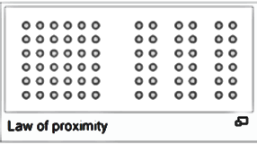
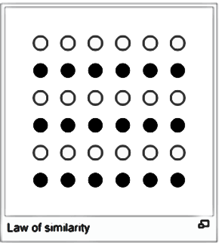
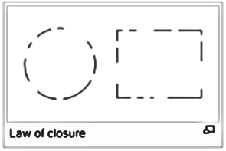
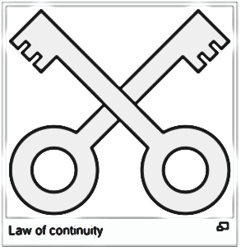
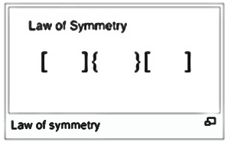
Patterns and Grouped Objects
One of the cool things our brains are really good at is automatically collecting and grouping disparate elements into a cohesive set

Slide 132
Patterns of Organization (and More!)
In Information Anxiety (Doubleday), Richard Saul Wurman proposed that there are just five ways to organize information, and suggested the mnemonic acronym LATCH:
• Location
• Alphabetical
• Time
• Categorical
• Hierarchical

Slide 133
Following sorts of relationships as possible axes or positional organizational schemes
Importance
Causality
Dependence
Categorical

Slide 134
Importance
A hierarchy variant where the most relevant information or the most important entities are at one end (usually the top or left) and the least important are at the opposite end
This works for everything from organizational charts to sales figures.
Apply your own priority and the direction you want the reader to consume the information.

Slide 135
Causality
Cause and effect, whether linear or cyclical, is a powerful organizational structure
If the organization is cyclical, consider a round structure, probably moving clockwise

Slide 136
Dependence
This is a great organizational scheme in which entities can be ranked as relatively more dependent and independent
Consider this for hierarchically related entities, such as object classes, libraries, etc.

Slide 137
Categorical
Not hierarchical, but absolutely useful
Consider clumping or grouping otherwise unordered data into categories
If nothing else, it’ll help your reader make sense of the volume of data you’re presenting

Slide 138
Specific Graphs, Layouts, and Axis Styles
List of some common visualization layouts and formats
Quantitative and comparative formats
Bar graphs-Line graphs-Pie graphs-Histograms-Time series-Scatter plots
Tables-Periodic tables- Treemaps-Heat maps-Small multiples
Marimekko (also known as matrix or mosaic) graphs
Relational formats
Data flow diagrams, Entity Relationship Diagrams, etc.
Decision maps and flow charts
Social network graphs
Spatial formats
Geographic map and Non-geographic map

Slide 139
Appropriate Use of Circles and Circular Layouts
Circles are really pretty
They’re also very frequently used to represent data
sadly, for all of their beauty, circles and circular layouts are usually used improperly, in ways that don’t allow efficient decoding of the data
The fundamental problem with using circles is that we’re not very good at estimating and comparing circular areas and radial measures, such as arc lengths and pie wedge sizes.

Slide 140
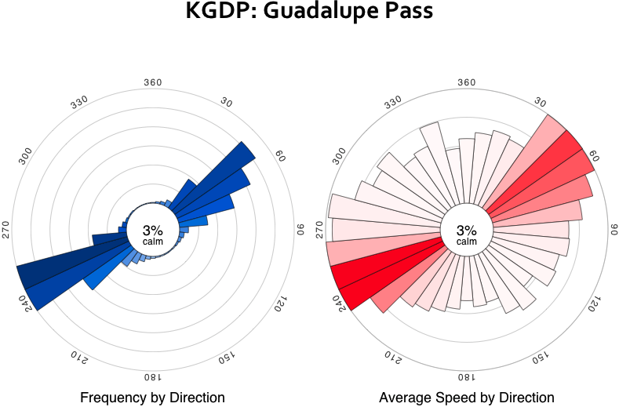
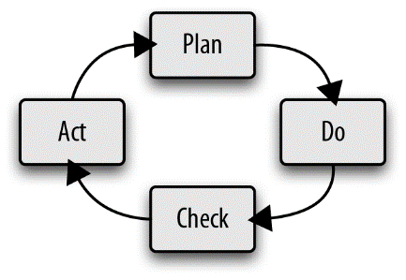
Good uses of circles and circular layouts
Cyclical relationships
Direction
Pie graphs
Area on bubble graphs

Slide 141
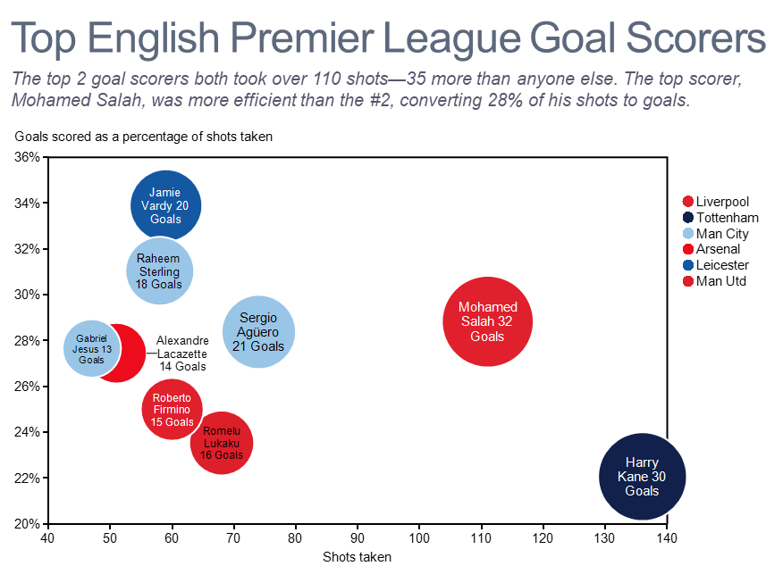
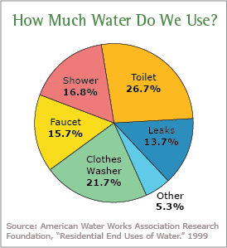

Slide 142
Bad uses of circles and circular layouts
Circular length and circular bar graphs
occasionally permissible, as in showing periods of time
Extracting meaningful comparisons from the data is very difficult under those circumstances
Pies with many or similarly-sized wedges
If you need precision, or have many fractions/wedges that matter, don’t use a pie graph.
In those cases, bar graphs with precise labels are a better bet.
Pies for values other than fractions of a whole
Pie graphs are only for comparing fractions of a whole measure.
If you are comparing other quantities—time data, or anything else—no pie for you!

Slide 143
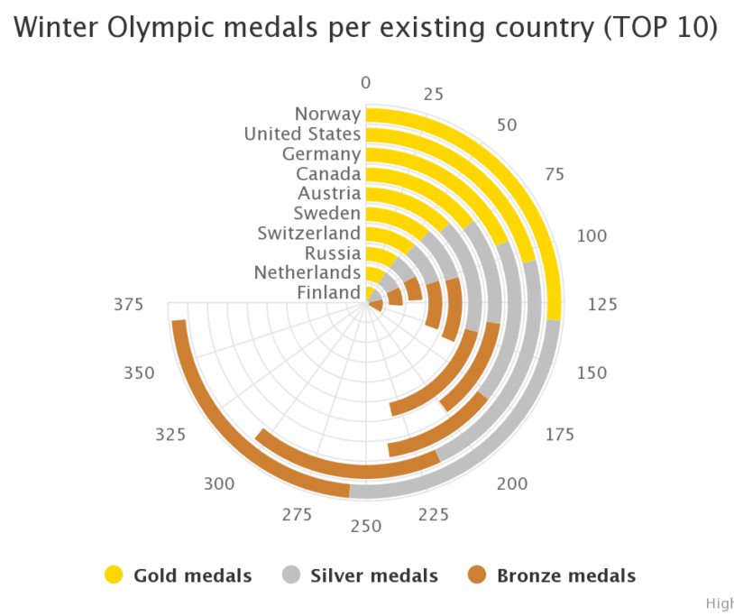
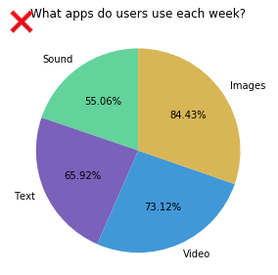

Slide 144
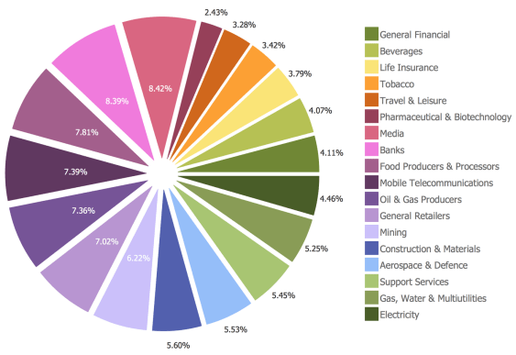
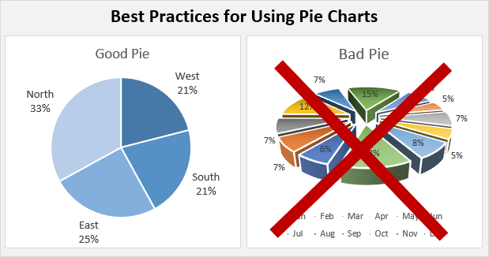
Notes:
Prepared by P.Rajasekar
Asst. Professor, SRMIST

